Slide 1
Density Seems to Matter The Impact of COVID-19 Pandemic on Housing Prices on Oahu Island, Hawaii
Patricia Yu, Ph.D.
Assistant Professor of Economics
University of Hawai'i West O'ahu
Jeremy R. Groves, Ph.D., ACUE
Associate Professor of Economics
Northern Illinois University
Presentation for the Illinois Economics Association Conference September 22, 2023

Slide 2
Key Questions
How did the government response to the Covid-19 Pandemic impact the value of residential property?
Was the consumer response to the Covid-19 Pandemic homogenous across residential property types?

Slide 3
Literature Review
Overall results are mixed, primarily due to the small window from which the data is drawn.
No Impact
Delgado & Katafuchi (2020) - Japan
Yoruk, B. K. (2022) – Metro Areas
Zeng & Yi (2022) – Wuhan area
Generally found decreases in volume but no discernable impact on price.
Negative Impact
Del Giudice, et. al. (2020): Italy (4.16%)
Hu, et. al. (2021) – Austrian (0.35 – 1.26%)
Qian, et. al. (2021): Ireland (2.47%)
Francke & Korevaar (2021): Amsterdam and Paris (risk premium ↑)
Liu & Su (2021): (shift by density)
Positive Impact
Kadi, et. al. (2020): Austria (B&B to Rental)
Verma & Husain (2020): Canada
Arcaya, et. al. (2020)
Yang & Zhou (2021): China
Mixed Impact
Li & Zhang (2021): US (population density)
Wang (2021): US Metro (Houston, Santa Clara, Irvine, Des Moines increase; Honolulu decrease)
Gupta, et. al. (2022): US (city vs. suburban)
D’Lima, et. al. (2022): US (population density)
Yang, et. al. (2023): China (low vs. high income housing)

Slide 4
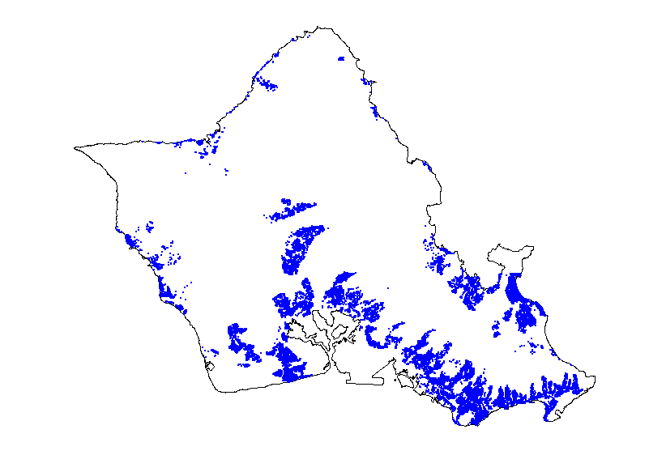
Data
All arms-length transactions from Multiple Listing Service of HiCentral MLS, Ltd. (thank you Honolulu Board of REALTORS®)
Original data held 57,217 transactions for 51,239 unique units.
After cleaning data, we are left with 50,394 observations over 43,057 unique units.
Sold Once | 36,367 units
Sold Twice | 6,075 units
Sold Three Time | 586 units
Sold Four or Five Times | 29 units

Slide 5
Data

Slide 6
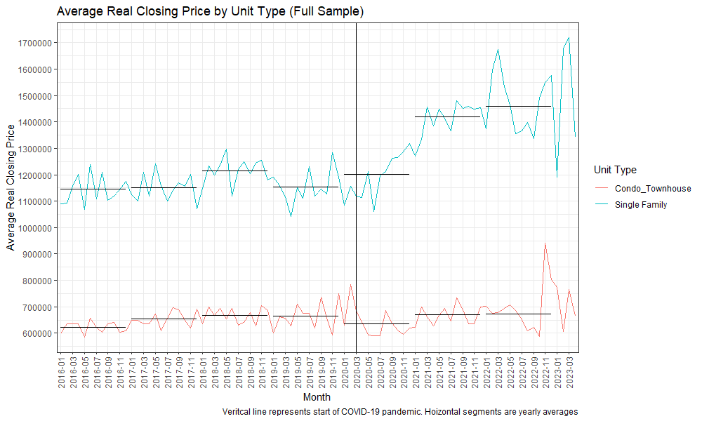
Data

Slide 7
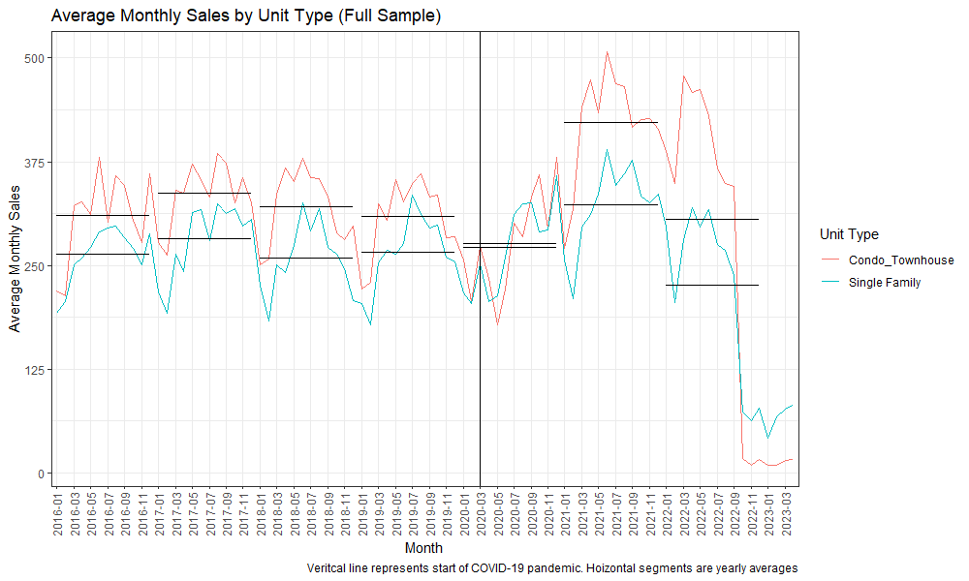
Data

Slide 8
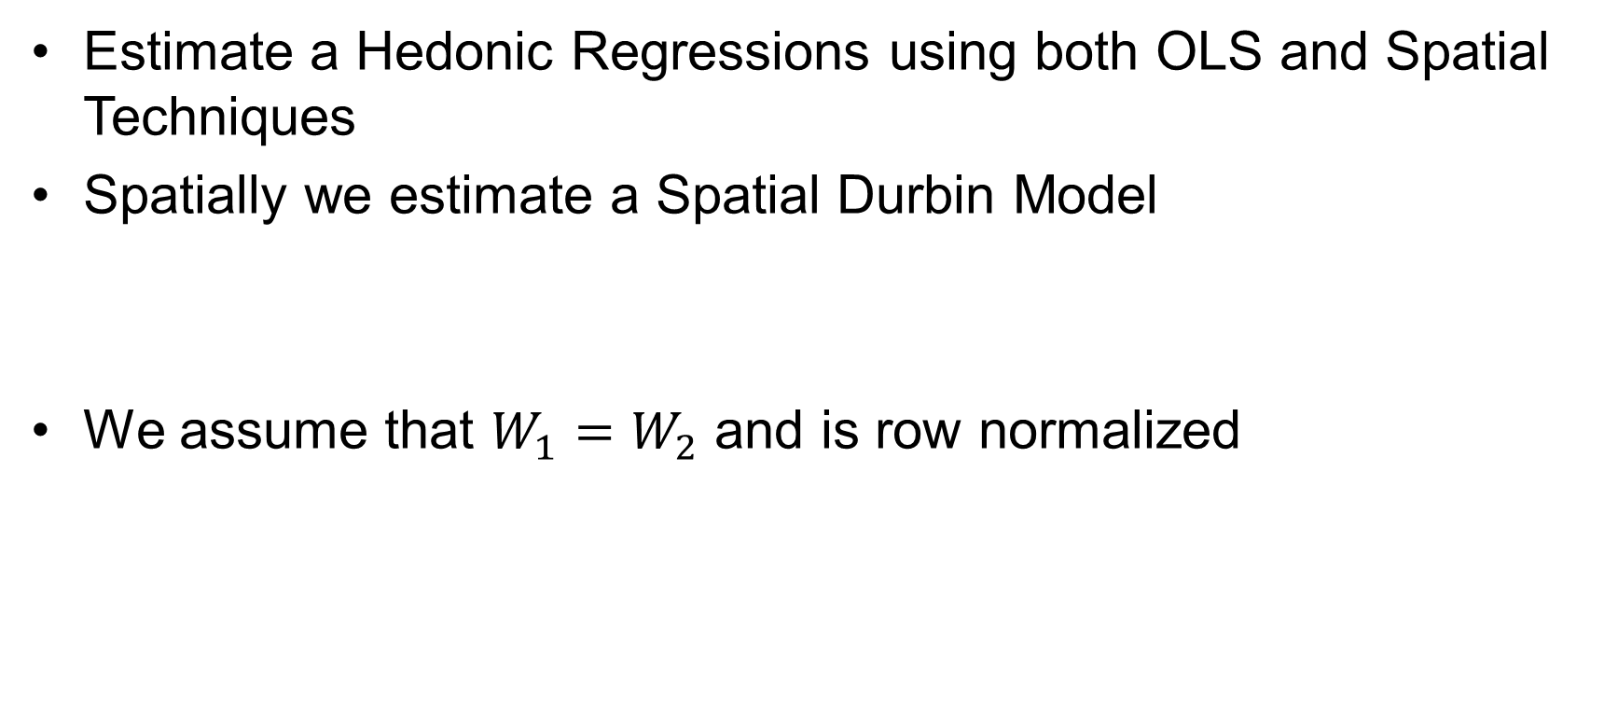
Methodology
Estimate a Hedonic Regressions using both OLS and Spatial Techniques
Spatially we estimate a Spatial Durbin Model
We assume that $W_{1}=W_{2}$ and is row normalized
$$\ln\left(P_{i}\right)=ρW_{1}P+β_{0}+{X_{i}β}_{1}+W_{2}Xθ+ε_{i}$$

Slide 9
Results

Slide 10
Results

Slide 11
Conclusions
Did the response to the Covid-19 Pandemic impact the value of residential property?
Yes, but….
Was the consumer response to the Covid-19 Pandemic homogenous across residential property types?
No, Single Family homes seem to benefit while condos and townhomes saw no impact at all.

Slide 12
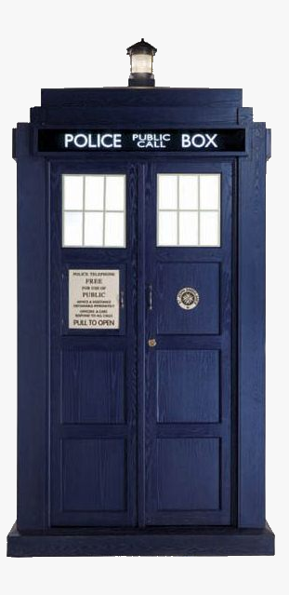
Problems/Future Research
Time Matters
We need to be able to keep the spatial aspects while also making sure that we are not using a future sale to predict the current sale in our spatial model.

Slide 13

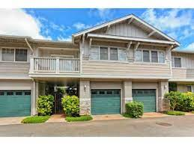
Problems/Future Research
Entering the 4th Dimension?
Several of the condo/townhomes are all located on the same plot of land and thus have the same coordinates. Especially difficult with high-rises

